Slide 1
ARM Architecture and Trace 32.
Gaurav Singh
23-May-07
80-Vnnnn-1 A
<Month Year>
Page <number>

Slide 2
ARM core
32 bit architecture
  Byte – 8 bits
  Word – 32 bits
  Half word – 16 bits
Two Instruction Sets
  32 bit ARM instruction set
  16 bit Thumb instruction set
37 Registers all of 32 bit long
  1 dedicated program counter
  1 dedicated current program status register
  5 dedicated saved program status registers
  30 general purpose registers
80-Vnnnn-1 A
<Month Year>
Page <number>

Slide 3
ARM working states
ARM state
  All instructions are 32 bit wide
  All instructions are word aligned
  Therefore PC value is stored in bits 31:2 are used
Thumb state
  All instructions are 16 bit wide
  All instructions are half-word aligned
  Therefore PC value is stored in bits 31:1 are used
80-Vnnnn-1 A
<Month Year>
Page <number>

Slide 4
General Purpose Registers
The unbanked registers
  r0 – r15
  user and system mode refer to the same physical registers
The banked registers
  r8_fiq – r12_fiq, r13_<mode>, and r14_<mode>
  The set of physical registers depend on the processor mode
  r13 is normally used as the stack pointer (SP)
  r14 is also known as the link register (LR), which is used to store the return address from a subroutine
Register 15, PC
  r15 is the program counter
80-Vnnnn-1 A
<Month Year>
Page <number>

Slide 5
Operating Modes
Seven operating modes:
  User
  Privileged:
    System (version 4 and above)
    FIQ
    IRQ
    Abort
    Undefined
    Supervisor
80-Vnnnn-1 A
<Month Year>
Page <number>

Slide 6
Operating Modes (2)
User mode:
  Normal program execution mode
  System resources unavailable
  Mode changed
  by exception only
Exception modes:
  Entered
  upon exception
  Full access
  to system resources
  Mode changed freely
80-Vnnnn-1 A
<Month Year>
Page <number>

Slide 7
Processor Modes
The ARM has six operating modes:
  User (unprivileged mode under which most tasks run)
  FIQ (entered when a high priority (fast) interrupt is raised)
  IRQ (entered when a low priority (normal) interrupt is raised)
  Supervisor (entered on reset and when a Software Interrupt instruction is executed)
  Abort (used to handle memory access violations)
  Undef (used to handle undefined instructions)
ARM Architecture Version 4 adds a seventh mode:
  System (privileged mode using the same registers as user mode)
80-Vnnnn-1 A
<Month Year>
Page <number>

Slide 8
Register Organisation
General registers and Program Counter
User32 / System
FIQ32
Supervisor32
Abort32
IRQ32
Undefined32
r0
r0
r0
r0
r0
r0
r1
r1
r1
r1
r1
r1
r2
r2
r2
r2
r2
r2
r3
r3
r3
r3
r3
r3
r4
r4
r4
r4
r4
r4
r5
r5
r5
r5
r5
r5
r6
r6
r6
r6
r6
r6
r7
r7
r7
r7
r7
r7
r8
r8_fiq
r8
r8
r8
r8
r9
r9_fiq
r9
r9
r9
r9
r10
r10_fiq
r10
r10
r10
r10
r11
r11_fiq
r11
r11
r11
r11
r12
r12_fiq
r12
r12
r12
r12
r13 (sp)
r13_fiq
r13_svc
r13_abt
r13_irq
r13_undef
r14 (lr)
r14_fiq
r14_svc
r14_abt
r14_irq
r14_undef
r15 (pc)
r15 (pc)
r15 (pc)
r15 (pc)
r15 (pc)
r15 (pc)
Program Status Registers
cpsr
cpsr
cpsr
cpsr
cpsr
cpsr
sprsr_fiq
sprsr_fiq
sprsr_fiq
sprsr_fiq
sprsr_fiq
spsr_fiq
spsr_svc
spsr_abt
sprsr_fiq
sprsr_fiq
sprsr_fiq
sprsr_fiq
sprsr_fiq
spsr_irq
spsr_undef
sprsr_fiq
sprsr_fiq
sprsr_fiq
sprsr_fiq
sprsr_fiq
80-Vnnnn-1 A
<Month Year>
Page <number>

Slide 9
Register Example:
User to FIQ Mode
Registers in use
Registers in use
User Mode
FIQ Mode
r0
r0
r1
r1
r2
r2
r3
r3
r4
r4
r5
r5
r6
r6
r7
EXCEPTION
r7
r8
r8_fiq
r8
r8_fiq
r9
r9_fiq
r9
r9_fiq
r10
r10_fiq
r10
r10_fiq
r11
r11_fiq
r11
r11_fiq
r12
r12_fiq
r12
r12_fiq
r13 (sp)
r13_fiq
r13 (sp)
r13_fiq
r14 (lr)
r14_fiq
r14 (lr)
r14_fiq
r15 (pc)
Return address calculated from User mode
PC value and stored in FIQ mode LR
r15 (pc)
cpsr
cpsr
spsr_fiq
spsr_fiq
User mode CPSR copied to FIQ mode SPSR
80-Vnnnn-1 A
<Month Year>
Page <number>
Notes:
Similarly in other 4 modes, though here only r13->r14 swapped.
“Banked” registers stored between mode swaps. Useful for interrupt handling because nothing to set up. Can thus run more quickly.

Slide 10
The Program Status Registers
(CPSR and SPSRs)
31
28
8
4
0
N
Z
C
V
I F T
Mode
Copies of the ALU status flags (latched if the
instruction has the "S" bit set).
* Condition Code Flags
* Interrupt Disable bits.
I = 1, disables the IRQ.
F = 1, disables the FIQ.
* T Bit (Architecture v4T only)
T = 0, Processor in ARM state
T = 1, Processor in Thumb state
N = Negative result from ALU flag.
Z = Zero result from ALU flag.
C = ALU operation Carried out
V = ALU operation oVerflowed
* Mode Bits
M[4:0] define the processor mode.
80-Vnnnn-1 A
<Month Year>
Page <number>
Notes:
Current Program Status Register (CPSR) can be considered as an extension of the PC. It contains the:
condition code flags, N,Z,C,V.
interrupt (FIQ, IRQ) disable bits
mode bits
T bit
Software must never change value in TBIT. If this happens, the processor will enter an unpredictable state.
Lower 28 bits known as the "control bits".
Bits other than the specified interrupt and mode bits are reserved for future processors, and no program should depend on their values.
The condition codes in the CPSR will be preserved or updated depending on the value of the S bit in the instruction.
Some instructions do alter condition flags regardless of “S”, ie CMN, CMP, TST and TEQ (return no other result).
Mode field bigger than needs to be - just history.
Only six modes valid on pre-ARM Architecture v4 chips.
SPSRs
Also five other PSRs, the Saved Program Status Registers, one for each privilege mode, into which a copy of the CPSR is loaded when an exception occurs.

Slide 11
Condition Flags
Logical Instruction Arithmetic Instruction
Flag
Negative No meaning Bit 31 of the result has been set
(N=‘1’) Indicates a negative number in
signed operations
Zero Result is all zeroes Result of operation was zero
(Z=‘1’)
Carry After Shift operation Result was greater than 32 bits
(C=‘1’) ‘1’ was left in carry flag
oVerflow No meaning Result was greater than 31 bits
(V=‘1’) Indicates a possible corruption of
the sign bit in signed
numbers
80-Vnnnn-1 A
<Month Year>
Page <number>
Notes:
N flag SUB r0, r1, r2 where r1<r2
Z flag SUB r0, r1, r2 where r1=r2 (also used for results of logical operations)
C flag ADD r0, r1, r2 where r1+r2>0xFFFFFFFF
V flag ADD r0, r1, r2 where r1+r2>0x7FFFFFFF
(if numbers are signed, ALU sign bit will be corrupted)
(0x7FFFFFF+0x00000001=0x80000000)
(answer okay for unsigned but wrong for signed)

Slide 12
Program Counter (r15)
When the processor is executing in ARM state:
  All instructions are 32 bits wide
  All instructions must be word-aligned
  Therefore the PC value is stored in bits [32:2] with bits [1:0] undefined (as instruction cannot be halfword)
When the processor is executing in Thumb state:
  All instructions are 16 bits wide
  All instructions must be halfword-aligned
  Therefore the PC value is stored in bits [32:1] with bits [0] undefined (as instruction cannot be byte-aligned)
80-Vnnnn-1 A
<Month Year>
Page <number>

Slide 13
Exceptions
Exceptions are usually used to handle unexpected events which arise during the execution of a program, such as interrupts or memory faults, also cover software interrupts, undefined instruction, and the system reset
Three groups:
  Exceptions generated as the direct effect of execution an instruction
    Software interrupts, undefined instructions, and prefetch abort
  Exceptions generated as a side effect of an instruction
    Data aborts
  Exceptions generated externally
    Reset, IRQ and FIQ
80-Vnnnn-1 A
<Month Year>
Page <number>

Slide 14
ARM recognizes 7 different types of Exception
  Reset: Occurs when processor reset pin is asserted.
  Undefined Instruction: Occurs if processor, does not recognize the currently executing instruction.
  Software Interrupt (SWI): This is a user-defined intentional synchronous interrupt instruction.
  Prefetch Abort: Occurs when processor attempts to execute an instruction that was not fetched, because the address was illegal.
  Data Abort: Occurs when a data transfer instruction attempts to load or store data at an illegal address.
  IRQ: Occurs when the processor external Interrupt ReQuest pin is asserted
  FIQ: Occurs when the processor external Fast Interrupt reQuest pin is asserted
80-Vnnnn-1 A
<Month Year>
Page <number>

Slide 15
Exceptions, in order serviced, are:
  Reset - supervisor mode
  Data abort - abort mode
  External Fast Interrupt Request - FIQ mode
  External Interrupt Request - IRQ mode
  Instruction Prefetch abort - abort mode
  Software Interrupt (SWI)- supervisor mode (typically used to extend operating system)
  Undefined instruction - undefined mode
Only one memory location for each vector
  Each vector contains branch to that particular exception handler
  FIQ vector is last one. This allows its handler to be run sequentially from that address, removing need for branch and its associated delays. Important because speed is essential for FIQ.
Interrupt routine’s responsibility to clear interrupt condition.
80-Vnnnn-1 A
<Month Year>
Page <number>

Slide 16
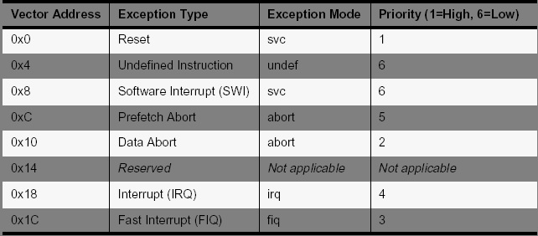
Exception Vectors
80-Vnnnn-1 A
<Month Year>
Page <number>

Slide 17
Exception Entry (1/2)
When an exception arises
  ARM completes the current instruction as best it can (except that reset exception)
  handle the exception which starts from a specific location (exception vector).
Processor performs the following sequence:
  Change to the operating mode corresponding to the particular exception
  Stores the return address in LR_<mode>
  Copy old CPSR into SPSR_<mode>
  Set appropriate CPSR bits
    If core currently in Thumb state then ARM state is entered.
    Disable IRQs by setting bit 7
    If the exception is a fast interrupt, disable further faster interrupt by setting bit 6 of the CPSR
80-Vnnnn-1 A
<Month Year>
Page <number>

Slide 18
Exception Entry (2/2)
  Force PC to relevant vector address
Priority | Exception | Mode | vector address
1 | Reset | SVC | 0x00000000
2 | Data abort (data access memory fault) | Abort | 0x00000010
3 | FIQ (fast interrupt ) | FIQ | 0x0000001C
4 | IRQ (normal interrupt) | IRQ | 0x00000018
5 | Prefetch abort (instruction fetch memory fault) | Abort | 0c0000000C
6 | Undefined instruction | UND | 0x00000004
 | Software interrupt (SWI) | SVC | 0x00000008
Normally the vector address contains a branch to the relevant routine
Exception handler use r13_<mode> and r14_<mode> to hold the stack point and return address
80-Vnnnn-1 A
<Month Year>
Page <number>

Slide 19
Exception Return
Once the exception has been handled, the user task is normally resumed
The sequence is
  Any modified user registers must be restored from the handler’s stack
  CPSR must be restored from the appropriate SPSR
  PC must be changed back to the relevant instruction address
80-Vnnnn-1 A
<Month Year>
Page <number>

Slide 20
Interrupt handling
The ARM has two levels of external interrupt- FIQ and IRQ.
However most systems have more than 2 interrupt sources !
  Therefore need an interrupt controller to control how interrupt are passed onto the ARM
  In many systems some interrupts will be higher priority than others- these will need to preempt any lower priority interrupt that may be being handled at that point in time.
  Note: An interrupt handler should always contain code which clears the source of interrupt.
Multiple
Peripherals
Interrupt
sources
Memory
Mapped
Interrupt
controller
IRQ
ARM
FIQ
80-Vnnnn-1 A
<Month Year>
Page <number>

Slide 21
FIQ vs IRQ
FIQ and IRQ provide very basic level of prioritization
FIQ have a higher priority than IRQs in two ways:
  Serviced first when multiple interrupts arise.
  Servicing an FIQ disables IRQs
    Irqs will not be serviced until after FIQ handler exists
FIQs are designed to service interrupts as quickly as possible.
  FIQ vector is last in vector table
    Allows handler to be run sequentially from that address ( without branch)
  FIQ mode has 5 extra banked registers (r8_FIQ to r12_FIQ)
      Interrupt handlers must always preserve non-banked registers
    Can have multiple FIQ sources, but avoid nested FIQs for best system performance
80-Vnnnn-1 A
<Month Year>
Page <number>

Slide 22
Software Interrupt
SWI instruction
  Forces CPU into supervisor mode
  Usage: SWI #n
31 28 27 24 23 0
Cond
Opcode
Ordinal
  Maximum 2²⁴ calls
  Suitable for running privileged code and
  making OS calls
80-Vnnnn-1 A
<Month Year>
Page <number>

Slide 23
Software Interrupts
User program
(C/ASM)
…
…
…
SWI 0x01
…
…
Vector table
SWI handler
(ASM)
SWI handler
(C)
(Optional)
User program invokes SWI
SWI handler contain Assembler part and optional C part
80-Vnnnn-1 A
<Month Year>
Page <number>

Slide 24
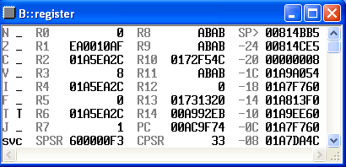
TRACE Basics
ARM Registers
Register Values
  Register values can be seen by using the register (or r) command
  R13 is the stack pointer (SP), R14 is the link register (LR)
  R15 is the program counter (labeled PC) and indicates the address of the instruction about to be executed
80-Vnnnn-1 A
<Month Year>
Page <number>

Slide 25
TRACE Basics
Data.list
Viewing code
  Source/assembly code can be viewed with the data.list (or d.l) command
  By default, the window will open to the location of the current PC (which is highlighted). Specific functions may be viewed by giving the function name (i.e. data.list rex_init)
  Assembly instructions can be toggled on/off with the Mode button
  Can click on variables to view values (or use variable.view [name] (or v.v) from the command line
80-Vnnnn-1 A
<Month Year>
Page <number>

Slide 26
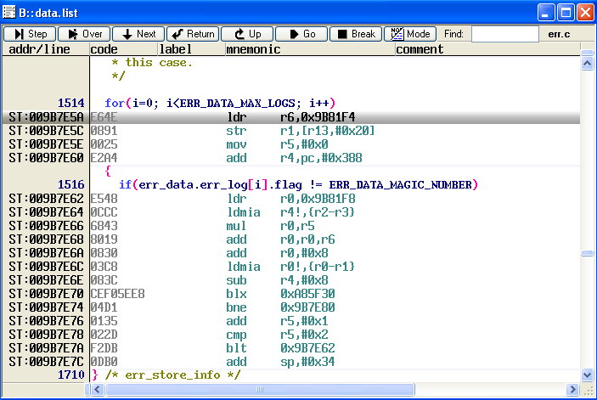
TRACE Basics
Data.list example
80-Vnnnn-1 A
<Month Year>
Page <number>

Slide 27
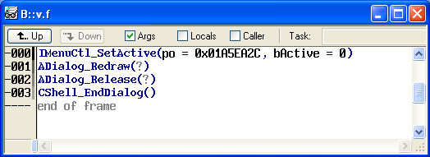
TRACE Basics
The Call Stack
The call stack will show the current function calls which are on the stack. It can be viewed by using the var.frame (or v.f) command.
The UP and DOWN buttons can be used to traverse up and down the call stack. TRACE will automatically adjust the PC, stack pointer, and other register values to correspond with the current level of the call stack.
80-Vnnnn-1 A
<Month Year>
Page <number>

Slide 28
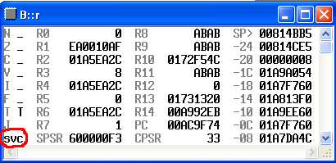
AMSS status
Interrupt or Task context?
The ARM processor mode should be checked to determine if an interrupt was being processed at the time of the error, or if a task was being executed. This can be seen in the register window in TRACE.
If the processor mode is svc (Supervisor), then the ARM is in task context. If the processor is in either sys (System) or irq mode, then an interrupt is being processed.
80-Vnnnn-1 A
<Month Year>
Page <number>

Slide 29
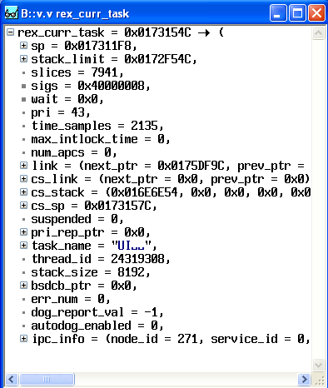
AMSS status
Which Task was running?
To determine which task is active at the time of the crash, look at the variable rex_curr_task, which will point to the tcb of the current task. This can be done with the following command:
v.v rex_curr_task
The tcb field task_name contains the name of the task. Change the format of this field to “string” to view the name (right click the task_name field, select Format…, then check the String box).
80-Vnnnn-1 A
<Month Year>
Page <number>

Slide 30
Stacks and Useful Variables
80-Vnnnn-1 A
<Month Year>
Page <number>

Slide 31
How Is A Task Context Saved
A Task Context is saved to the Task Stack as:
tcb->sp | CPSR
tcb->sp+4 | R0
tcb->sp+8 | R1
tcb->sp+12 | R2
tcb->sp+16 | R3
tcb->sp+20 | R4
tcb->sp+24 | R5
tcb->sp+28 | R6
tcb->sp+32 | R7
tcb->sp+36 | R8
tcb->sp+40 | R9
tcb->sp+44 | R10
tcb->sp+48 | R11
tcb->sp+52 | R12
tcb->sp+56 | R14 (LR)
tcb->sp+60 | R15(PC)
80-Vnnnn-1 A
<Month Year>
Page <number>

Slide 32
Useful Variables
rex_int_nest_level:
  Shows IRQ/System mode or Svc Mode and nest interrupt level
rex_sched_allow:
  If 0, TASKLOCK is called
rex_core:
  Captures register values at time of exceptions. Can be load by load_rex_core.cmm
err_data:
  It is the same as rex_core in normal case. However it can capture back-to-back exceptions
  err_data.err_log[x].flag = 0xXXXXXXXXXXXX4144 to be a valid log
  Can be used if rex_core is not valid for some reason
rex_task_list
  A link list of rex task list.
80-Vnnnn-1 A
<Month Year>
Page <number>

Slide 33
Types of Errors
Software generated errors
For software generated errors, the current stack frame (viewable with the var.frame command) should indicate where the error was generated.
  Error Fatals: The file and line number of the code which generated the error is displayed on the LCD (or can be found on the call stack). Typically the responsible developer should be contacted to help understand why the error occurred.
  Divide by zero(System Signals): These are raised by the ARM libraries when an error condition is detected. The source of the error can be found be traveling up the stack frame.
  Soft Resets: Caused when the software jumps to address 0x0 during normal execution (typically by using a NULL function pointer). This is not a true reset of the phone.
80-Vnnnn-1 A
<Month Year>
Page <number>

Slide 34
Types of Errors
Software generated errors (cont)
SW dog timeouts: Technically an error fatal, these are generated when a task (indicated by the error message) has not reported to the dog task within its allotted time.
The stack frame in these cases will always show the stack for the dog task, which is not helpful in debugging the error. Analysis of dog_state_info and dog_task_state, in addition to checking the contexts of other tasks, is needed to try and determine the root cause of the timeout.
If FEATURE_SOFTWARE_PROFILE_CPU_STARV_DET has been defined, lo_pri_task_pri and lo_pri_task_tcb will indicate the lowest priority task to recently report to dog. This will often help indicate which task is the source of the problem.
80-Vnnnn-1 A
<Month Year>
Page <number>

Slide 35
Types of Errors
Software generated errors (cont)
tmc_heap errors: There is an error fatal that indicates the tmc_heap is out of memory. This can be caused by a memory leak, or by a task allocating too much memory for itself.
80-Vnnnn-1 A
<Month Year>
Page <number>

Slide 36
Thank You
80-Vnnnn-1 A
<Month Year>
Page <number>

